Slide 1
Recent Research in
Water Use and Conservation for
Nursery and Greenhouse Production
Joshua Knight
Extension Associate, Nursery Crop Production
Department of Horticulture
University of Kentucky
http://NCER.ca.uky.edu
http://cleanwater3.org/

Slide 2
Water conservation in the Ohio River Valley? (4m)
    Army Corps of Engineers 2017 Report on Climate Change
USDA National Survey Results (2m)
    What are Nursery Growers using?
    What practices and technologies have they heard of?
How are they being compared? (20m)
    Understanding Water Footprint
Technologies/Practices (20m)
    Conservation vs Remediation vs Recycling
    Ponds / Managing Runoff
    Filtration Systems

Slide 3
Ohio River Basin is historically “water-rich” with droughts and major flooding events considered “isolated”
Droughts | Major Flooding Events
1988 | 1997
2002 | 2010
2007 | 2011
Army engineers warn of brutal future for Ohio River region from climate change
Louisville Courier Journal - Published 11:10 a.m. ET Nov. 30, 2017
US Army Corps of Engineers Report (321 pages):
https://NCER.ca.uky.edu/research
Increased Variability of Precipitation

Slide 4
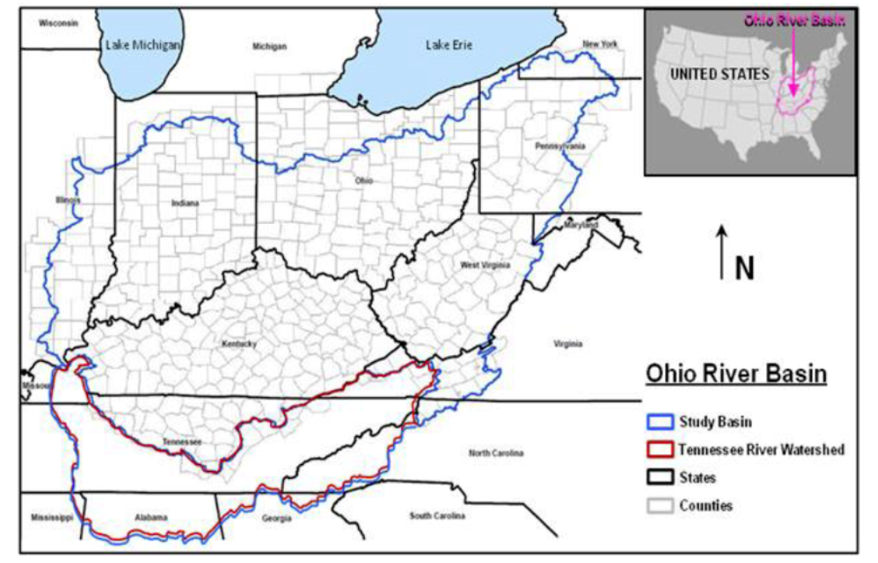

Slide 5
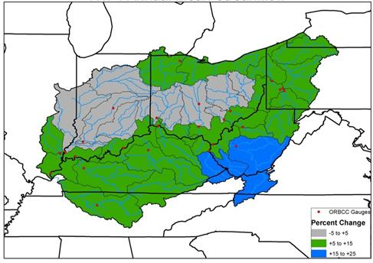
Percent Change Streamflow
Annual - Average
Time Period
2011-2040
Compared to 1952-2001

Slide 6
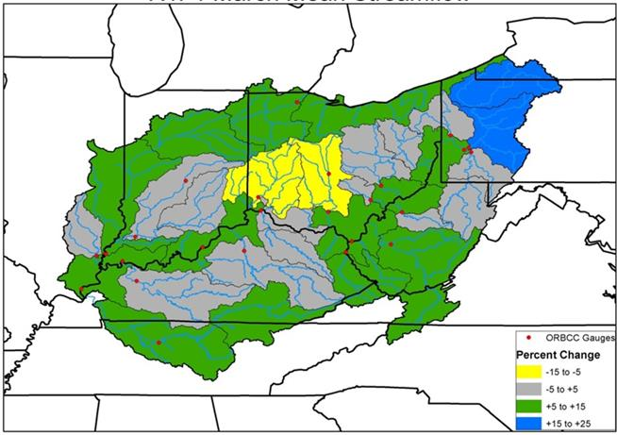
Percent Change Streamflow
March - Average
Time Period
2011-2040
Compared to 1952-2001

Slide 7
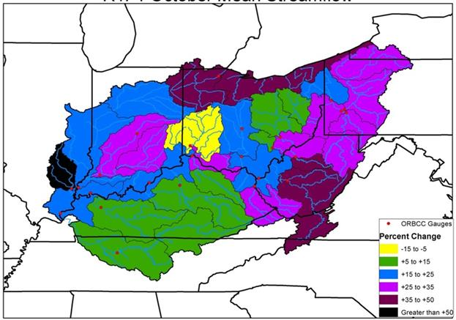
Percent Change Streamflow
October - Average
Time Period
2011-2040
Compared to 1952-2001

Slide 8
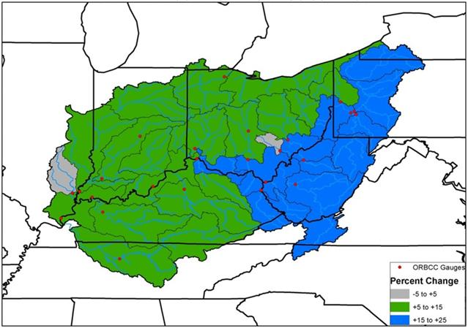
Percent Change Streamflow
Annual - Maximum
Time Period
2011-2040
Compared to 1952-2001

Slide 9
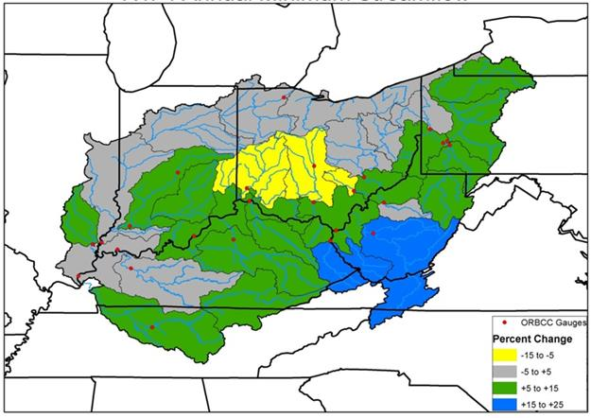
Percent Change Streamflow
Annual - Minimum
Time Period
2011-2040
Compared to 1952-2001

Slide 10
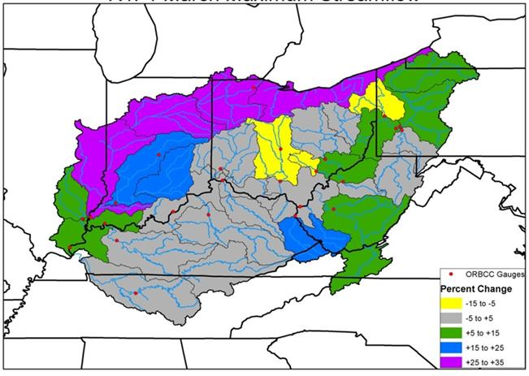
Percent Change Streamflow
March – Maximum
Time Period
2011-2040
Compared to 1952-2001

Slide 11
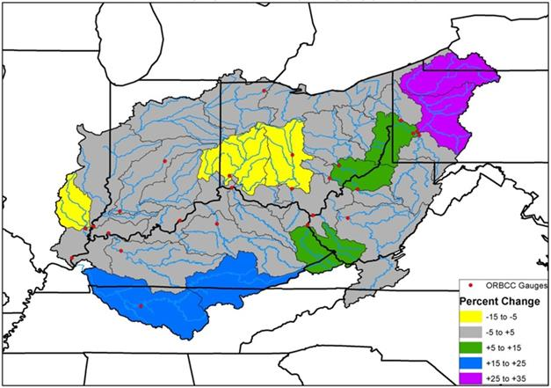
Percent Change Streamflow
March – Minimum
Time Period
2011-2040
Compared to 1952-2001

Slide 12
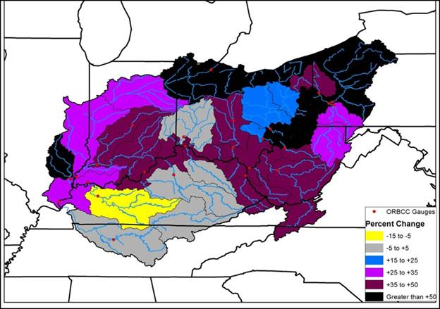
Percent Change Streamflow
October - Maximum
Time Period
2011-2040
Compared to 1952-2001

Slide 13
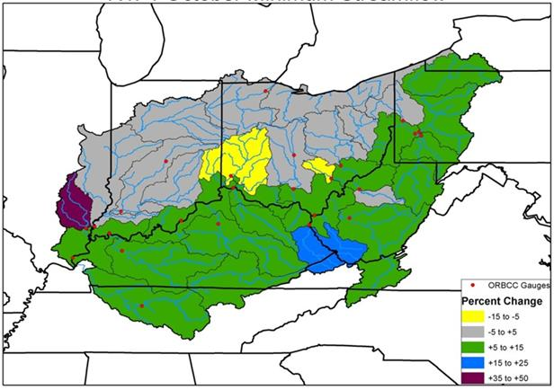
Percent Change Streamflow
October - Minimum
Time Period
2011-2040
Compared to 1952-2001

Slide 14
Summary until 2040…
Overall ~10% higher streams across KY throughout year
Not necessarily even, potential for periods of
  Prolonged drought
  Excessive precipitation
More water, but it might not come when we need it.
Higher variability north of Ohio River!

Slide 15
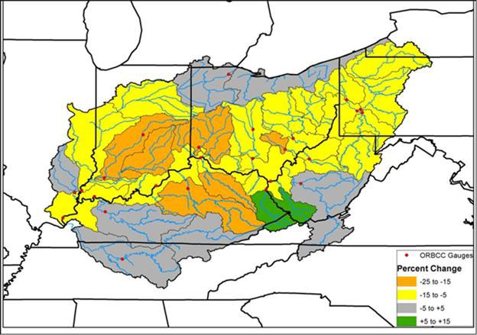
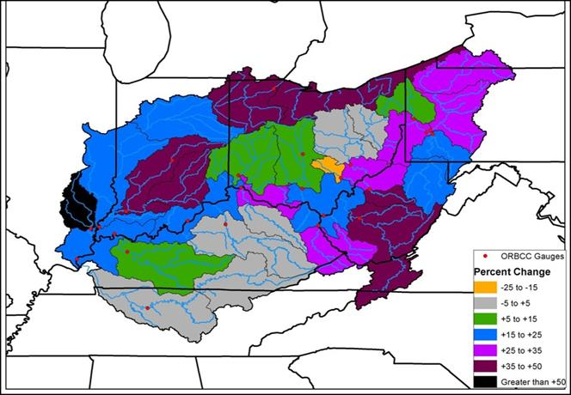
After 2040…
Variability is more extreme!
October Min
October Max

Slide 16
More irrigation/agriculture ponds in KY?
Figure 10-4: Distribution of Current Water Supply Reservoirs in Cultivated Crop Areas

Slide 17
SCRI Water3 – National INTERVIEW RESULTS

Slide 19
Water sources

Slide 20
Use of Treatment Technologies

Slide 21
Use of Conservation Technologies

Slide 22
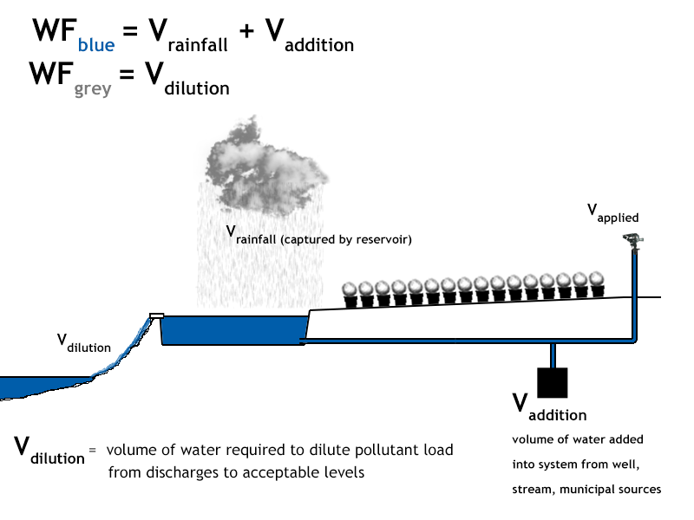
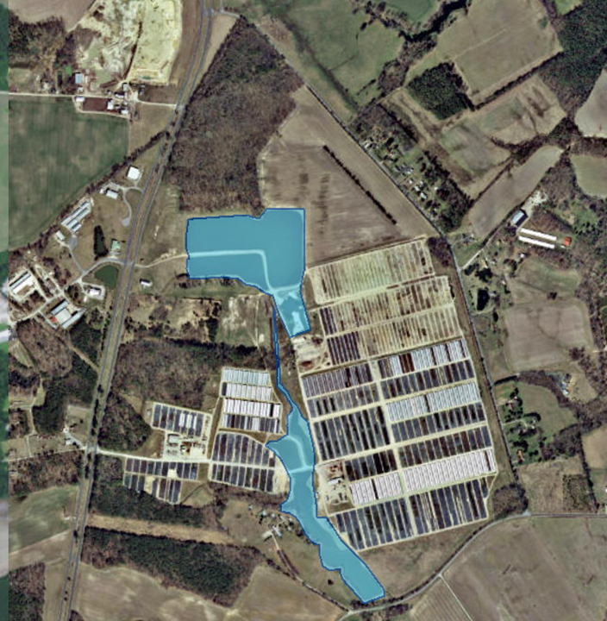

Understanding Water Footprint
http://CleanWateR3.org/

Slide 23
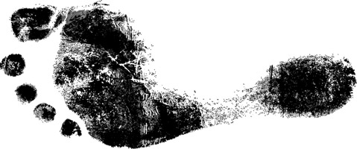
Water Footprint
Footprint -> IMPACT
Similar in basic concept to a Carbon Footprint / Ecological Footprint

Slide 24
Water Footprint
“Consumptive Use” of water is defined by impact.
Water used for one purpose cannot be used for another purpose at the same time.
Ex. Captured rainfall runoff that has evaporated behind a dam cannot flow downstream and provide habitat.

Slide 25
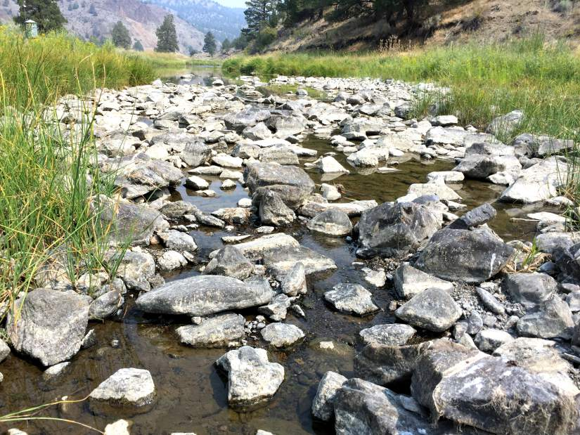
Relevant or Competitive uses of water…
Water Footprint
Irrigation
Drinking water
Ecological Requirements
- Dilution of pollutants
- Habitat support
ex. aquatic animals, vegetation

Slide 26
Is All Consumptive Water Use Equal?
(mostly) No!
Critical Factors:
  Location
  Time of Year
BUT, comparisons between geographic locations should include unweighted Water Footprint volumes.

Slide 27
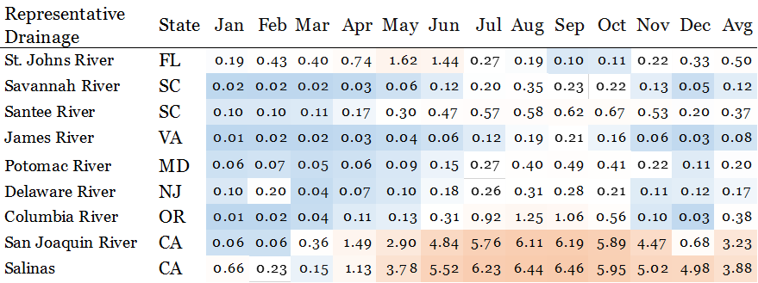
Selected Water Scarcity Indices (2011)
A Water Scarcity Index is a ratio equal to
CONSUMPTIVE WATER USE
AVAILABILITY

Slide 28
Purpose of Water Footprint Analysis
International Standard
&
Broad Application

Slide 29
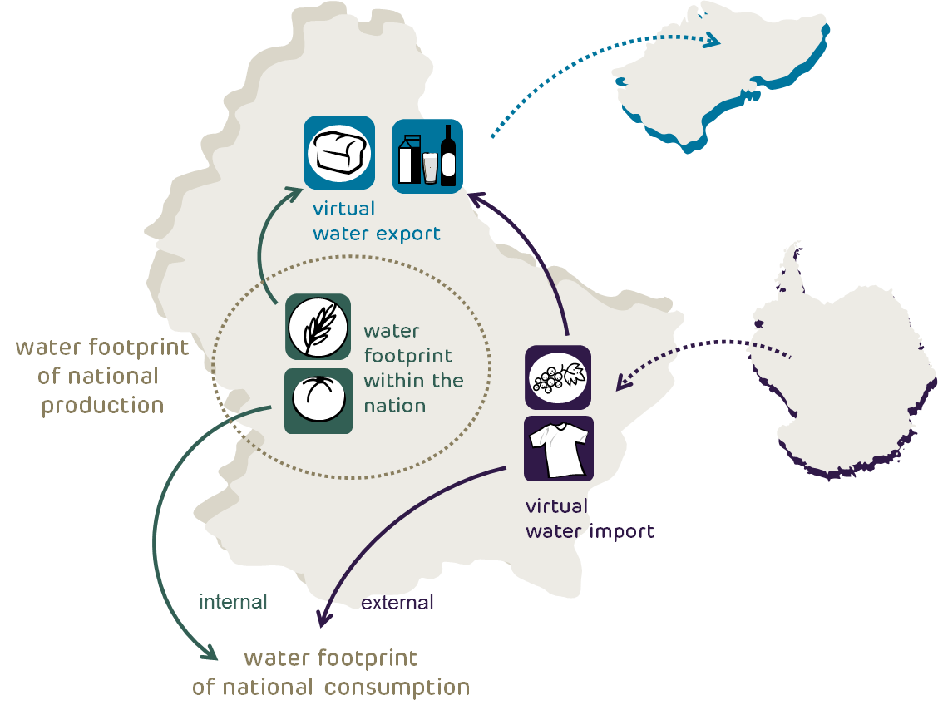
Purpose of Water Footprint Analysis
International Standard
Due to international trade,
freshwater is becoming a global resource.
&
Consumers are spatially disconnected
from water resources.

Slide 30
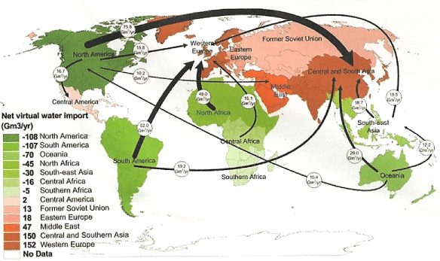
Virtual water balance per country and direction of gross virtual water flows related to trade in agricultural and industrial products over the period 1996-2005. Only the biggest gross flows (> 15 Gm3 /yr) are shown; the fatter the arrow, the bigger the virtual water flow.

Slide 31
Purpose of Water Footprint Analysis
International Standard
Not a stick to beat on water by consumers or producers, but rather a method to analyze consumptive water use and ultimately
make practical improvements.

Slide 32
Purpose of Water Footprint Analysis
Broad Application
Water footprint can allow comparisons
Companies
Products
Commodities
Communities
Individuals
Comparing Water Footprint
Smartphone 240 gallons
Cotton T-shirt 26 gallons
Cup of Coffee 35 gallons
Direct Consumption 27 gallons per day
-washing, cleaning, etc.
Plastic Bottle (1 pint) 1.4 gallons

Slide 33
How it works…
Basic Water Footprint Calculation in Nursery Production
Embodied WF
Green WF
Grey WF
+ Blue WF
Total Water Footprint

Slide 34
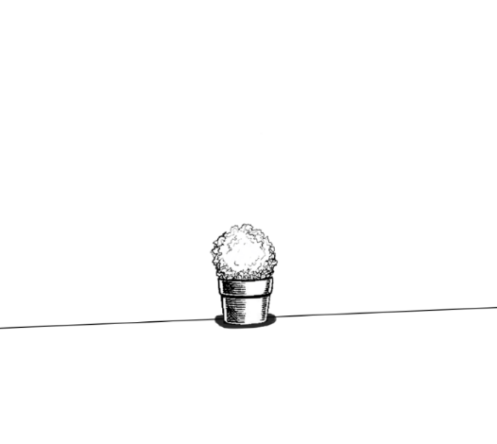
How it works…
Basic Water Footprint Calculation in Nursery Production
Embodied WF = Weighted volume of water required for fabrication of inputs
Ex. for field production phase of holly in a #3 container…
Injection molded HDPE plastic container
= 0.534 Gallons (weighted)
Herbicides (total)
= 0.262 Gallons (weighted)
….
Total Embodied WF
= ~ 4.2 Gallons (weighted)

Slide 35
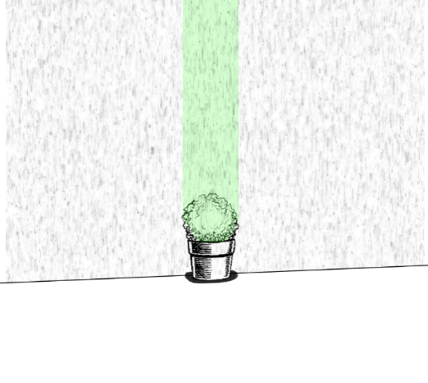
Basic Water Footprint
Green WF = water used directly during atmospheric events
Calculated as
Volume of irrigation events avoided due to precipitation

Slide 36
Grey WF is “simple”:
Measure or estimate volume and pollutant load of discharges
Aside from metered additions, Blue WF is complex:
How much rainfall runoff is there to capture?

Slide 37
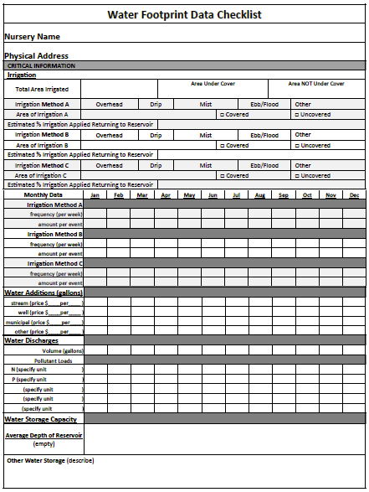
How? – Calculating WF
Interview Grower
Complete Checklist
Get Climate Data (30-Y normals)
Calculate Green WF
Calculate Grey WF
Model Captured Rainfall Runoff
Calculate Blue WF

Slide 38
How? – Calculating Water Footprint
Soil
Type
Flow Length
Land Cover
Rainfall
Intensity
Slope
How much of typical rainfall is caught?

Slide 39
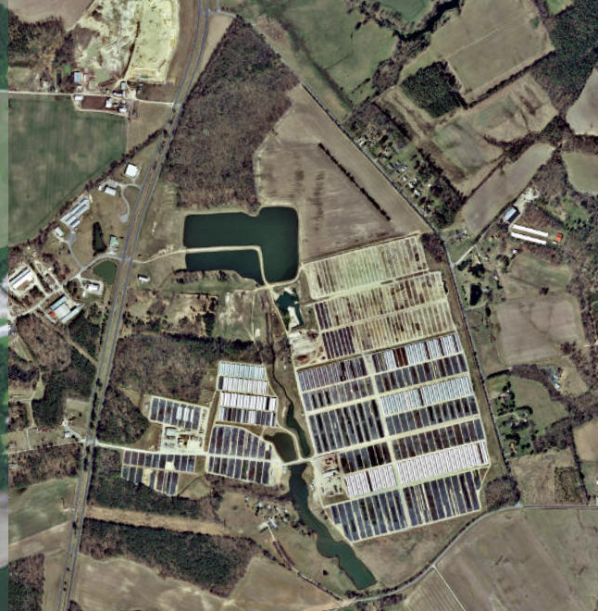
Calculating Blue WF
Find location
Physical address
or
GPS Coordinates

Slide 40
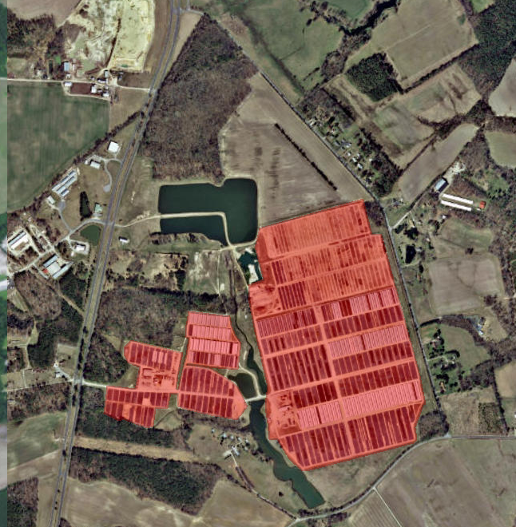
How? – Calculating WF
Define production / irrigated area
Models tell us how much runoff can be expected from given rainfall and irrigation

Slide 41
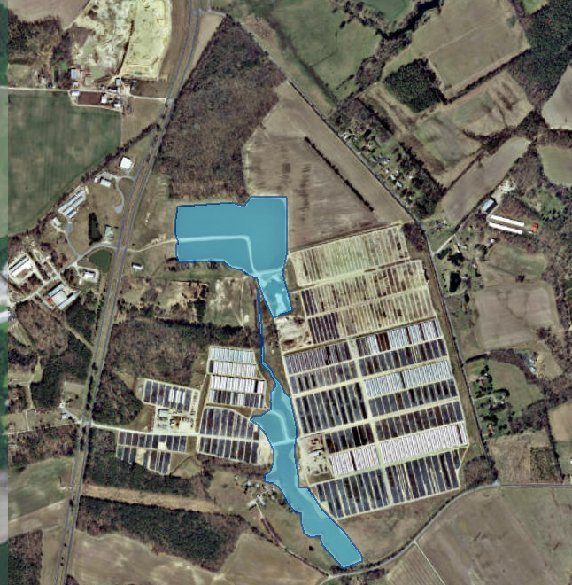
How? – Calculating WF
Define water reservoirs
100% of rainfall captured in reservoir

Slide 42
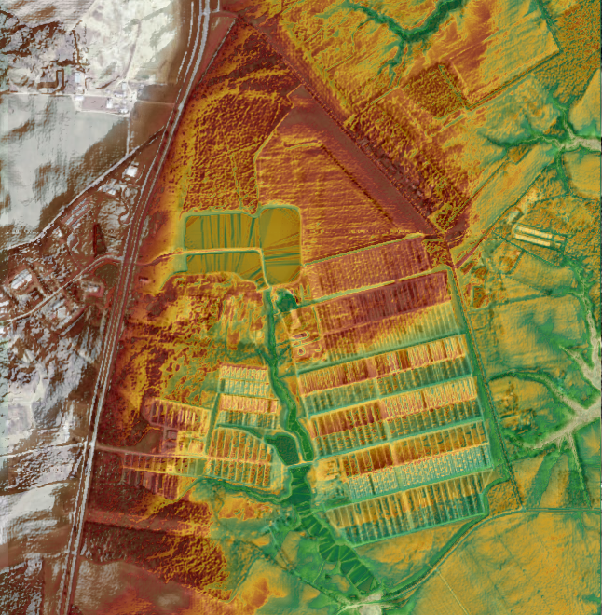
How? – Calculating WF
Find boundaries of catchment
  Elevation map
  Find Flows
  Boundaries

Slide 43
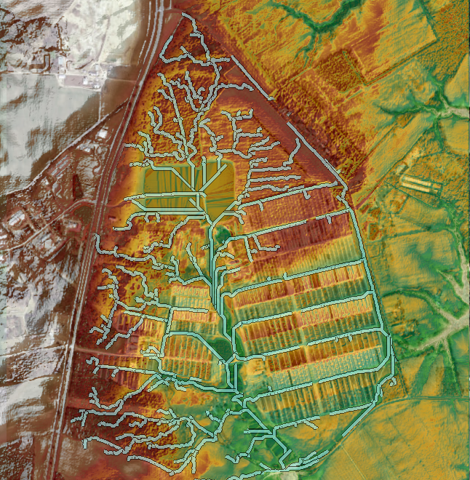
How? – Calculating WF
Find boundaries of catchment
  Elevation map
  Find Flows
  Boundaries

Slide 44
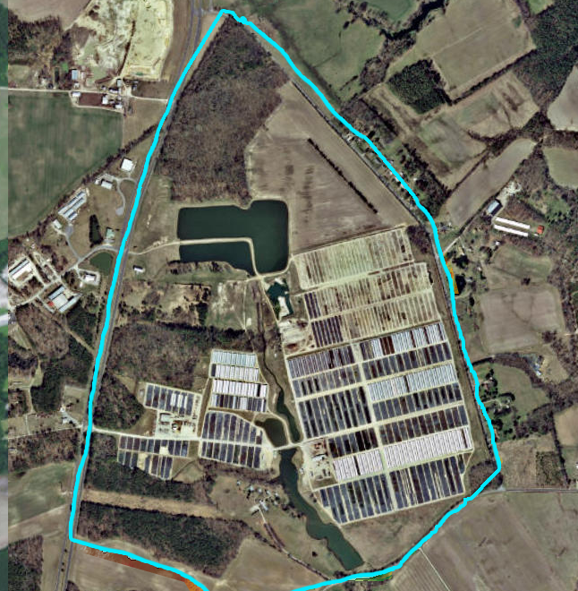
How? – Calculating WF
Find boundaries of catchment
  Elevation map
  Find Flows
  Boundaries

Slide 45
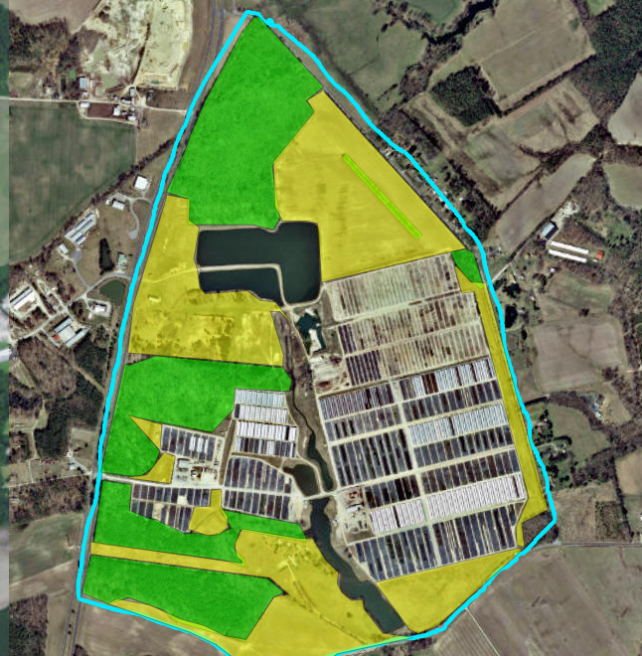
How? – Calculating WF
Define land cover*
Trees/woods, grasses
*only necessary for unengineered areas

Slide 46
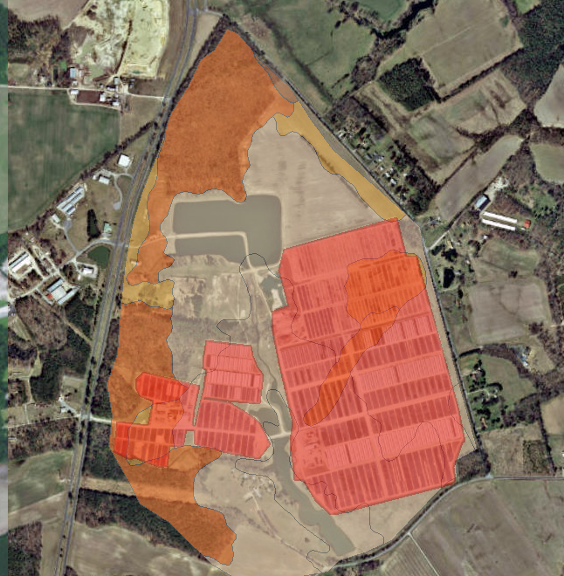
How? – Calculating WF
Find soil drainage types*
*only necessary for unengineered areas

Slide 47
Rainfall Intensity (monthly)
Rainfall intensity estimated from 30-year normals (1981 – 2010)
Jan
Feb
Rainfall (inches) 30-yr average | 3.33 | 3.01
Rainfall events => 1 inches | 0.8 | 0.9
Rainfall events => 0.5 inches | 2.6 | 2.4
Rainfall events => 0.1 inches | 6.5 | 5.9
Rainfall events => 0.01 inches | 10.1 | 9.6

Slide 48
Soil
Type
Flow Length
Land Cover
Rainfall
Intensity
Slope
Total Captured Runoff is compared with Reservoir Capacity and estimated losses to evaporation (monthly)…
You can only capture what you can use
or hold!
Total Captured
Runoff

Slide 49
Captured Rainfall
+ Additions
Blue Water

Slide 50
Example Estimated Calculations
Green Water Volume
Grey Water Volume
+ Blue Water Volume
Total Water Volume
30 m gallons / yr
50 m gallons / yr
300 m gallons / yr
380 m gallons / yr
For entire catchment area!

Slide 51
From Total Water Volume
=> Per Plant Consumptive Water Use:
(Total Water Volume per year)(Length of Production Cycle)
(Plant Density)
(Total Production Area)

Slide 52
Ex. #3 Container Buxus (U.S. East Coast)
Water Volume of Consumptive Use
Characterized by Water Type
9.97 gallons
8.01 gallons
Green Water Volume
Blue Water Volume
Grey Water Volume
98.34 gallons
Total = 116.32 gallons

Slide 53
Ex. Greenhouse 72 Cell Tray
Water Volume of Consumptive Use Characterized by Production Use
6.41 gallons
Misting (4 weeks)
Ebb & Flood (8 Weeks)
Swamp Cooler (12 Weeks)
18.52 gallons
5.60 gallons
Total = 30.53 gallons

Slide 54
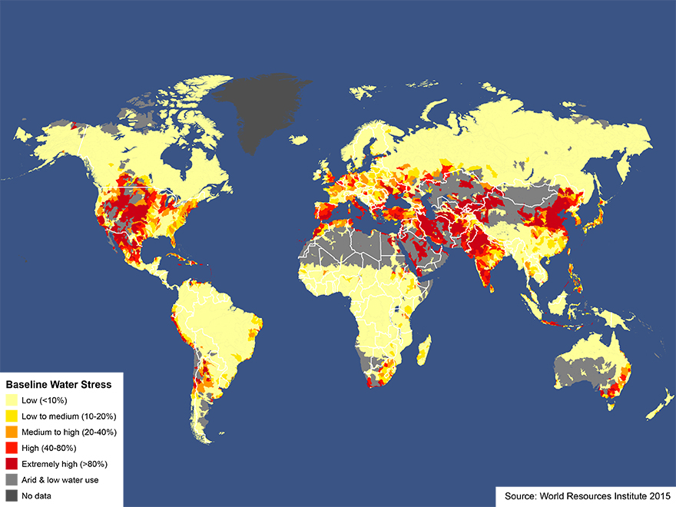
What about scarcity?

Slide 55
Water Volume vs.
Weighted Water Volume
Appropriate for comparing changes in water use efficiency from system changes
  irrigation schedule
  recycling techniques
Appropriate for comparing system efficiencies among similar systems with variable water scarcity.
Appropriate for comparing environmental impacts across systems with variable water scarcity.
Appropriate for quantifying environmental impact to location throughout year.
Moving Target! … Changes with shifting climate (availability) and use changes.

Slide 56
How is scarcity calculated?
Multiple methods, attempting to answer the question
“What is the potential to deprive another freshwater user—human or ecosystem—by consuming freshwater in this region?”
Generally expressed as in range between .01 and 100.

Slide 57
How is scarcity calculated?
Generally expressed as in range between
.01 ---------------------------------------------- 100
Low scarcity
(water abundance)
High scarcity
(water limited)
Calculation Methods
Withdrawal-to-Availability ratio (WTA) ~2008 (early)
Consumption-to-Availability ratio (CTA) ~2012 (common)
Inverse of Availability minus Demand (AWARE) ~2017 (new)

Slide 58
Selected Water Scarcity Indices (2011)
A Water Scarcity Index is a ratio equal to CONSUMPTIVE WATER USE
AVAILABILITY
1.0 = All Available Water is Being Used

Slide 59
Weighted Water Footprint =
∑
( )
Monthly Water Volume (Blue + Grey)
Marketable Plants in Production Area
x Monthly Scarcity Index
+
Green Water Volume
Marketable Plants in Production Area

Slide 60
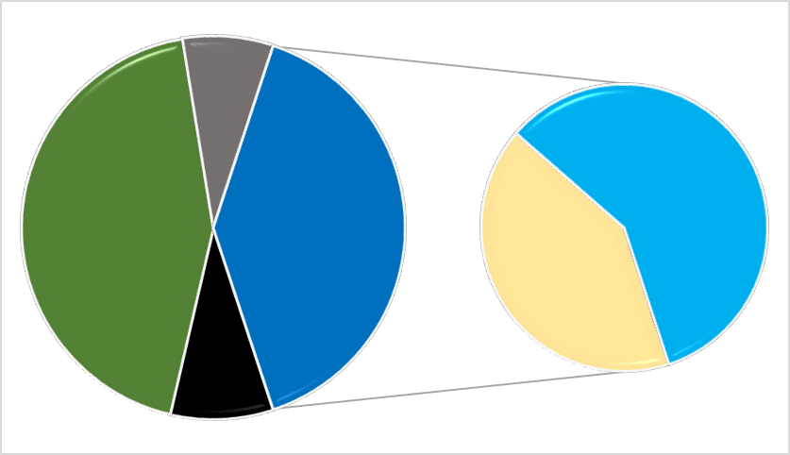
Example: Preliminary WF of a single, marketable #3 Container Holly, East Coast U.S.
3.5 gal
11.1 gal
21.1 gal
18.9 gal
7.8 gal
4.2 gal
Total: 47.7 Weighted Gallons
Embodied WF
Blue WF
Blue WF from Reservoir Evaporation
Green WF
Grey WF
Blue WF from Irrigation Events

Slide 61
Technologies and Practices
What is pushing development/implementation?
Droughts
Increased Competition for Water
Regulation
  Runoff capture/control from irrigated agriculture
    (CA, FL, MD, OR, TX)
  Waste Discharge Permits for Nurseries (CA)
  Numeric Nutrient Criteria / N and P Limits (FL)
  Chesapeake Bay Watershed – Total Maximum Daily Load (WV, VA, MD, DE, PA, NY)

Slide 62
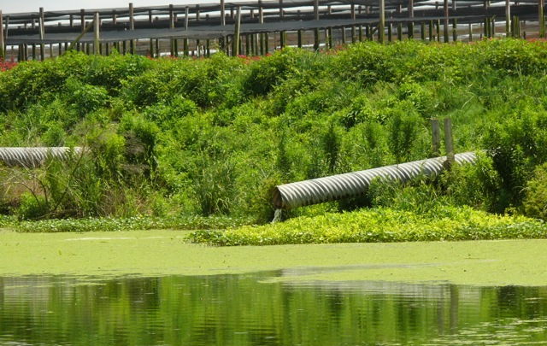
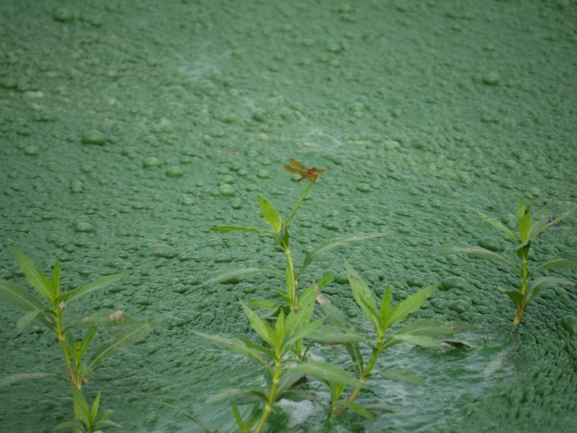
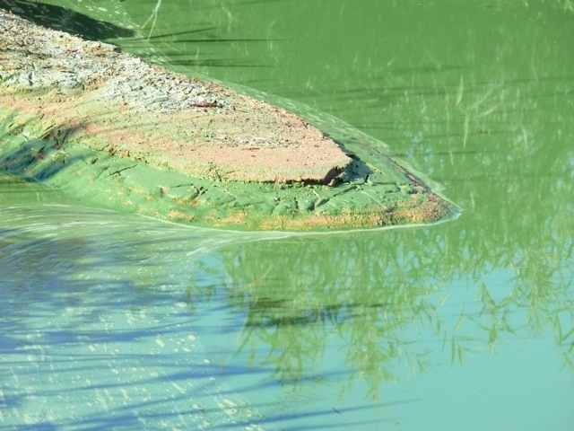
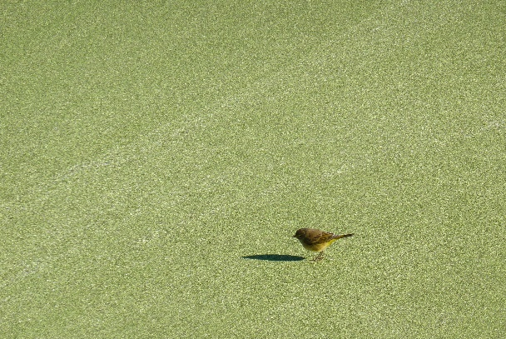
Nutrient contaminants
Algae
Aquatic weeds
Duckweed so thick, birds walk on it…

Slide 63
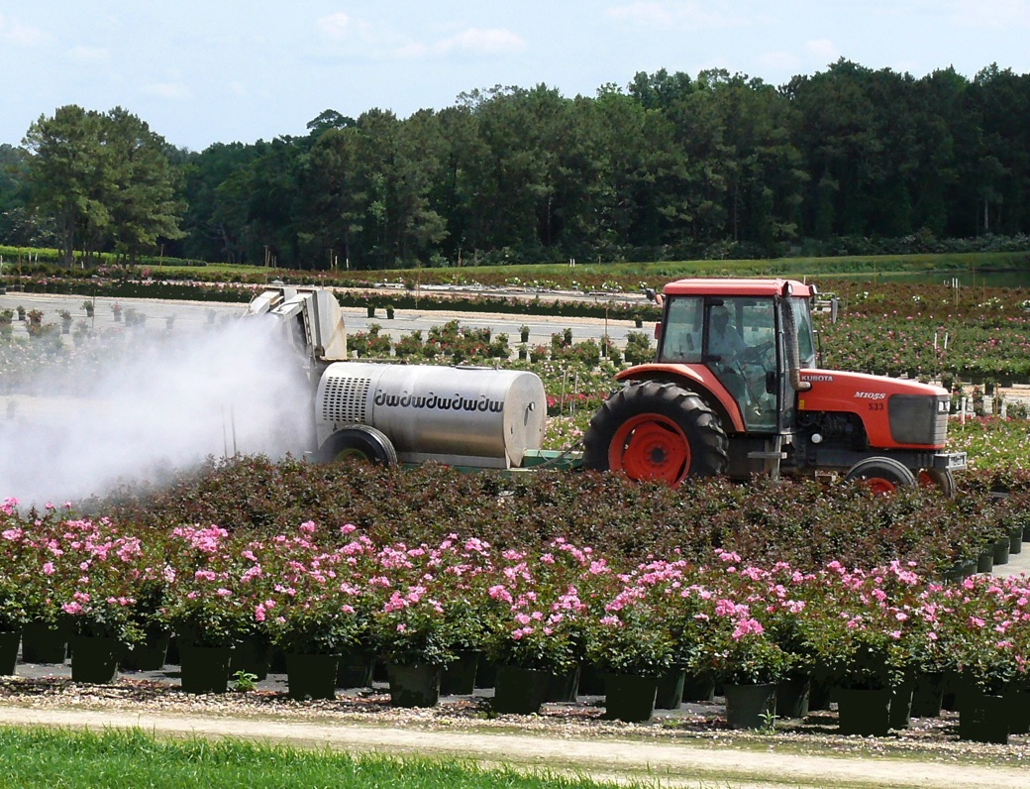
Pesticide contaminants

Slide 64
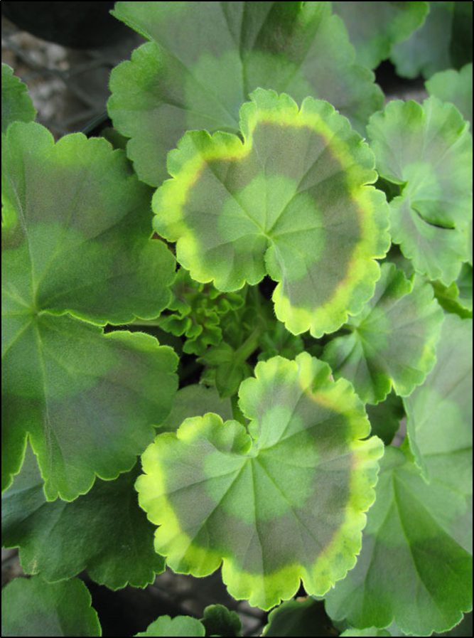
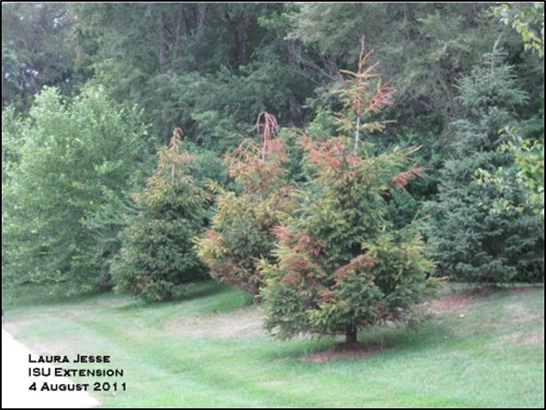
Herbicide/Growth regulator contaminants
Imprelis phytotoxicity
Cycocel phytotoxicity

Slide 65
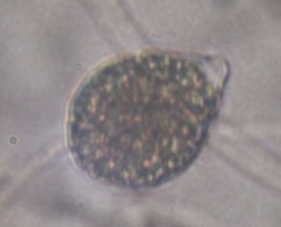
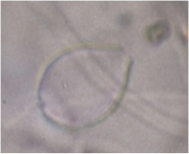
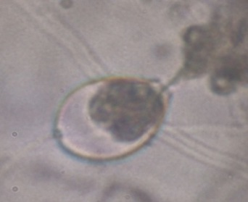
Pathogen contaminants
Waterborne pathogens
  perennial problem
  billions in crop losses
Photo: E. Nyberg
Chemically-based treatment systems are effective, but have
significant upfront costs
operational expenses
worker safety issues
Potential for environmental harm
Sporangia (Phytophthora nicotianae) release of zoospores into irrigation water can lead to plant infection.

Slide 66



Conserving
Recycling
Remediating

Slide 67
Conservation
Generally, applying less water through irrigation strategies and systems.
“dry” nursery
ET replacement
irrigating at night
Drip irrigation

Slide 68
Recycling
Capturing and conditioning irrigation water for re-use:
Ebb/Flood
Channels/Drainage/Ponds
Chlorination for pathogens
Filtration for herbicides/Growth regulators

Slide 69
Remediation
Capturing and conditioning used irrigation water for return to the environment/community:
Channels/Drainage/Ponds
Filtration for herbicides
Reducing nutrient loads

Slide 70
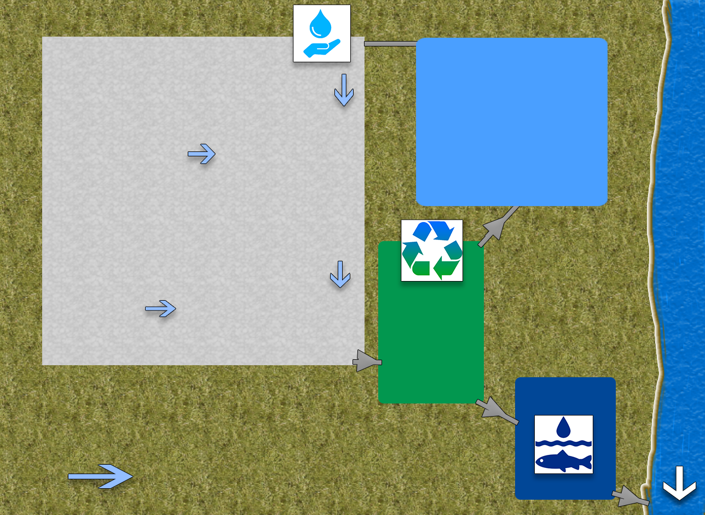
Irrigation Pond
Nursery Pad
Catchment
Pond
Constructed
Wetland

Slide 71
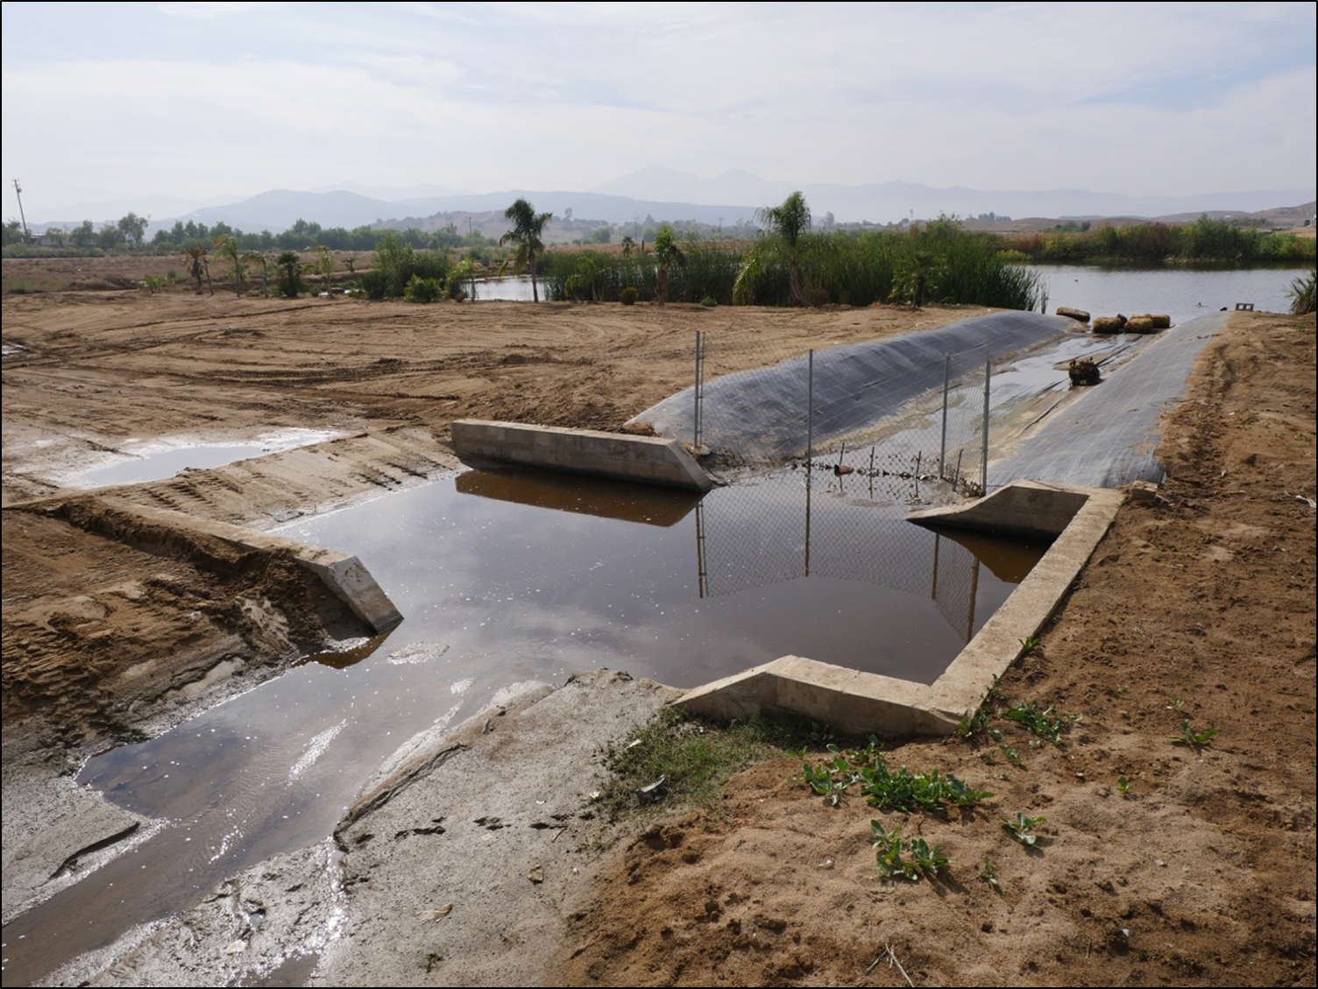
Types of Ponds
Sedimentation Ponds / Catch Basins
Routing runoff through control structures to limit sediment movement

Slide 72
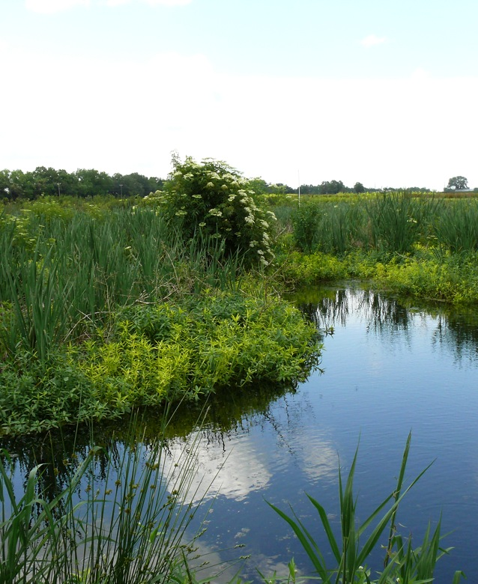
Types of Ponds
Constructed Wetland
“Constructed water (wetland) treatment basins”
Captures nutrients, sediment, pesticides

Slide 73
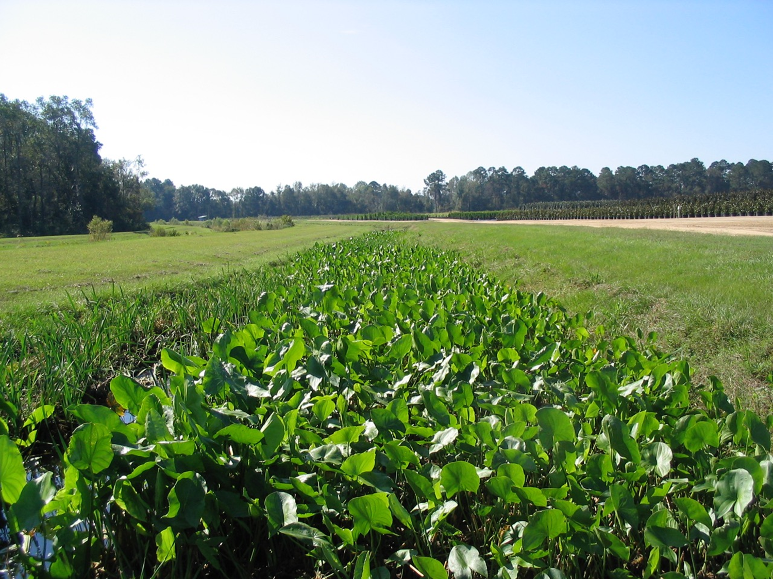
Types of Ponds
Vegetative waterways
Captures nutrients, sediment, pesticides

Slide 74
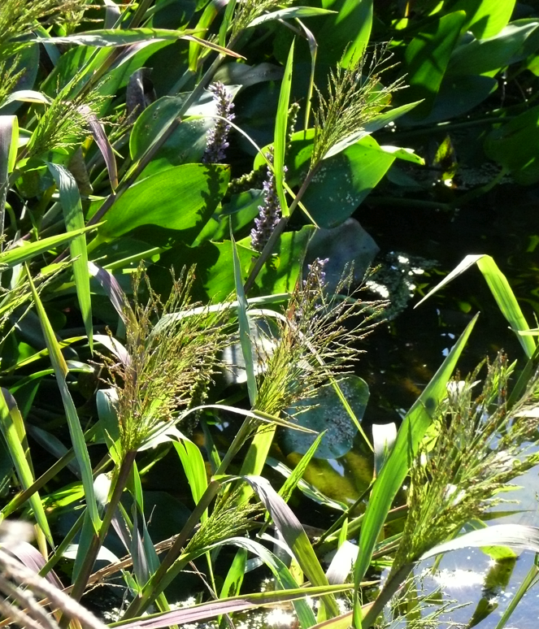
Wetland (water basin) functions
Soils provide habitat for microbes
Microbes process
  nutrients
  organic contaminants
Vegetation slows water
Plant uptake/absorption
  nutrients
  trace metals
  other compounds

Slide 75

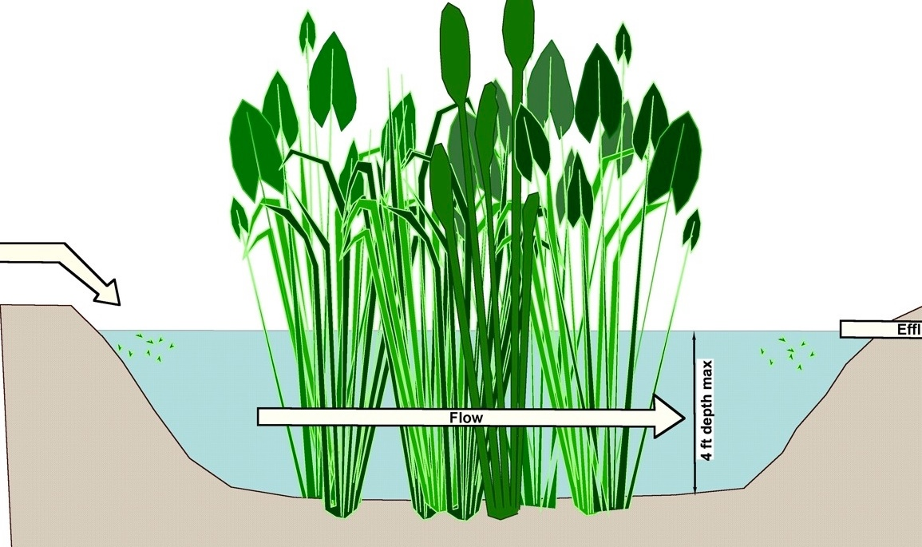
Shallow 6” to 15” freshwater marsh
Retain water for 3-3.5 days
Recommend 2’-3’ deep
For smaller footprint, can increase depth to max 4’

Slide 76
Nitrogen results

Slide 77
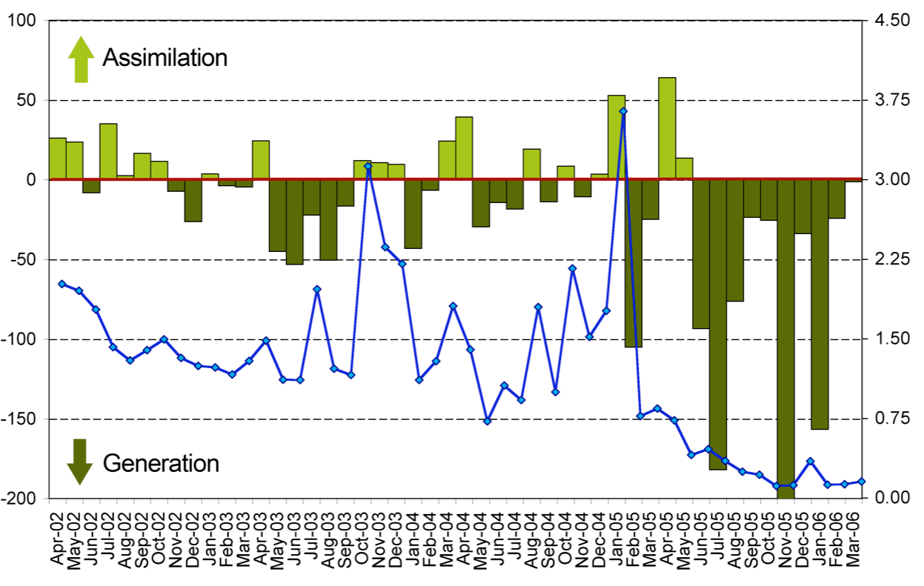
Phosphorus results

Slide 78
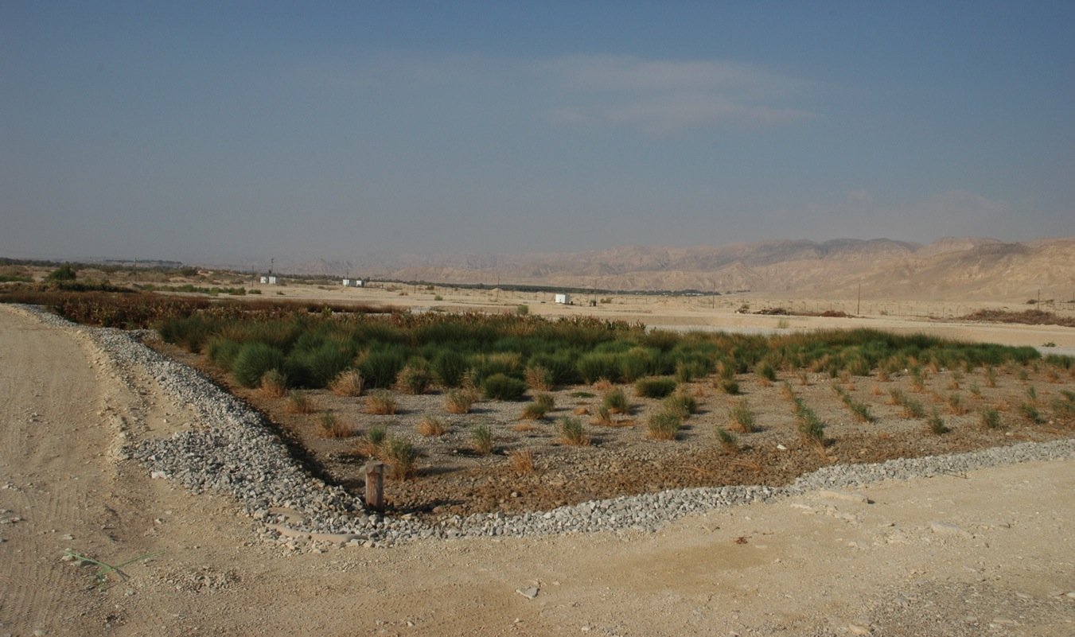
Subsurface flow constructed wetlands

Slide 79

Subsurface flow constructed wetlands
When targeting phosphorus, instead of pea gravel, the subsurface flow lining should be a pre-screened fired-clay nugget.
2’-deep layer of coarse medium (pea gravel)

Slide 80

Phosphorus removal
Subsurface flow CWs treatment enhanced phosphorus removal
Vegetated subsurface flow wetlands increased longevity of phosphorus removal
Monitor for phosphorus saturation of clay
  Removal efficiency declines as binding sites fill, replace clay

Slide 81

Floating wetlands (smaller scale)

Slide 82

Floating treatment wetlands (FTWs)

Slide 83
Sand Filtration
Rapid sand filtration
    Coarse sand (>1mm)
    Removes larger particles only
    Does not remove pathogens
    Does not remove pollutants
    18 – 180 gpm/yd²
    Low maintenance

Slide 84
Sand Filtration
  Slow sand filtration
    Removes pathogens
    Removes many pollutants
    Low maintenance
    Slow flow rates 0.5–2 gpm/yd²

Slide 85


Mechanism - physical
Screening/ straining
Adsorption/ attachment
Sedimentation
(Huisman and Wood, 1974)
http://bikonwater.com/pressure_sand.html

Slide 86



Mechanism - biological
“Schmutzdecke”- most treatment occurs
Community of microorganisms
  algae
  bacteria
  diatoms
  zooplankton
Predation, assimilation, attachment to biofilms
photo-dict.faqs.org/phrase/621/bacteria.html

Slide 87

System Design

Slide 88

Graphic: L. Oki
Notes:
1. Captured runoff is stored in a reservoir or containment. Runoff typically occurs in surges following irrigation events or storms.
A float switch monitors the water level. If there is runoff present, it is pumped to the sand filters.
2. Two sand filters are used so that when one is out of service for maintenance, the other can remain in operation. Overflow from the sand filters is returned to the reservoir.

Slide 89

Notes:
Flow control is critical for optimal treatment efficiency. The sand beds must remain submerged.
Treated water is stored for later use.

Slide 90

Notes:
The treated water is pressurized for reuse for irrigation.
If there is no runoff to be treated, cleaned water needs to return to the sand filters to maintain flows through the sand bed.

Slide 91

Notes:
6. If there is no treated water available for irrigation, then an alternative water supply needs to be used.

Slide 92

Installations
Estimated treatment capacity
Surface area ≈ 50 sq.ft. (5’x10’)
@ 0.5gpm/yd² → 4,400 gpd
Photo: L. Oki
Berylwood Tree Farm, Somis, CA
Notes:
Septic tanks can be used to contain the sand beds. This installation will have two of these tanks.
These tanks are estimated to contain sand beds estimated at 5’ x 10’. So, at 50 sq.ft. each, that these tanks will be able to treat 4,400 gpd @0.5gpm/yd^2 or a total of 8,800 gpd.

Slide 93

Evaluation of Alternatives to Sand
crushed brick Kaldnes®
sand calcined clay polyethylene beads
. . . Faster water treatment rates?
Notes:
*Preliminary research
Sand- Typically used
Crushed brick -Recycled material
Calcined clay- Reduces phosphorus in water by sorption
Kaldnes- moving biofilter bed, used in fisheries, used in waste water treatment ***** loook up more
Polyethylene beads- same material as Kaldnes but different physical characteristics
Hoping to find a substrate alternative to sand that is both effective at pathogen removal and has the potential for faster flow rates, or less clogging

Slide 94
Relative colony counts
Flow Rate = 30 mL/min
Notes:
This data set shows the removal of Phytophthora capsici from the runoff water. The lighter colored bars indicate the reference quantity of colony forming units prior to treatment and the darker bar represents the sample below the sand bed (post treatment). The date runoff was introduced to the filters is 5/3 and the reduction in the height of the bars below the reference bar indicates removal of the pathogen. This data shows that the biofilms take about 15 days to fully develop. Sand still the best, especially at first. After biofilm forms, brick, clay and beads are still very good.

Slide 95
Conclusions
Biological treatment systems:
Require little or no inputs
  Contrast with energy (UV irradiation) or chemical-based (chlorination) methods
Can remove nutrients, chemical pollutants, and pathogens

Slide 96
Conclusions
Land use for treatment systems instead of production
Slow sand filtration
Low flow rates: storage of large volumes of water
Constructed wetlands
Higher flow rates: adequate retention time for treatment

Slide 97
Conclusions – Slow Sand Filter
Both vegetated and slow sand systems require long residence times
Slow sand filters can clog if water contains particulates
Efficient water treatment systems may consist of combinations of treatment methods
  Vegetated or slow sand systems alone can provide adequate treatment
  Paired systems may be able to provide greater flow rates

Slide 98

Cleanwater3.org

Slide 99


Granular Activated Carbon (GAC)
Grower Location Experiment
U.F. Experiment

Slide 100

The Plant Growth Regulator Paclobutrazol
  Active ingredient in Bonzi, Paczol, Piccolo, Piccolo 10XC.
  Compact plants
Applied as spray or drench typically 1-200 ppm
Active in ppb range. 6 month half-life in water
50 ppb
10 ppb
5 ppb
Levels found in ponds & tanks

Slide 101


Increasing GAC contact time increases paclobutrazol removal: Begonia test
Paclobutrazol at 50 ppb
No Paclo
No filter
12 sec
GAC filtration
59 sec
GAC
filtration
No filter

Slide 102
Grower Location
Ornamental greenhouse operation
  3 GAC Filters in series
  Tank Volume: 264 gal
  17 to 50 gal/min flow rate
  Minimum Contact time: 3.3 min/filter (10+ min total)

Slide 103
Three crop cycles varied in paclo application rate

Slide 104


Slide 105
GAC Conclusions
Design for 15:1 volume to flow (for example, 1500 gal filter for 100 gal/min gives 15 minute contact time)
Cost for 50 gal/min GAC filter in 20-acre ebb-and-flood system:
Item | Capital | Per Year
GAC filter | $20,800 | $2,800
Pump & pre-filter | $6,600 | $660
GAC (one change/year) | $2,550 | $2,550
Labor for maintenance (3 h/week @ $25) |  | $3,990
Monthly test paclo before & after filter @ $70/sample |  | $1,680
Total | $29,950 | $11,680

Slide 106

visit cleanwater3.org & NCER.ca.uky.edu www.facebook.com/ReduceRemediateRecycle/
Notes:
Clean WateR3 is federally funded by the USDA-Specialty Crops Research Initiative in partnership with the Water Education Alliance for Horticulture.
Subscribe to newsletter.

